Slide 1
CLASSIFICATIO TECHNIQUES
By Group 12:
Chinmay Bhat
Ram Warutkar
Sakshi jain

Slide 2
INTRODUCTION
Commercial bank receive a lot of applications for credit cards. Many of them get rejected for many reasons like high debt, low income, etc
Manually analyzing these application sometimes become a mundane and time consuming process
To deal with this we have applied various machine learning techniques which will automate this process

Slide 3
DATASET AND analysis
The dataset is taken from the UCI website. Here is the link for the same:
https://archive.ics.uci.edu/ml/datasets/credit+approval
This dataset has 9 categorical features and 5 quantitative features
The categorical features are Gender, Married, Ethnicity, Driver License, Bank Customer, Education Level, Prior Default and Citizen
The quantitative features like income, debt, and years employed has a high correlation with the target variable which suggest that, these all are important factors in making a decision of approving or rejecting an application

Slide 4
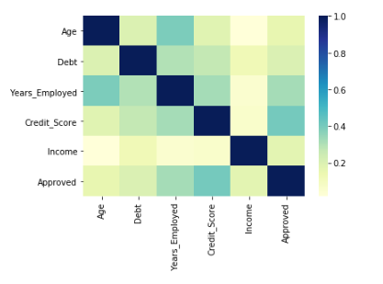
Correlation matrix
The heatmap also shows the strong correlation between target variable and other quantitative features

Slide 5
Data Preprocessing
The dataset contains some missing values which has been replaced by mean, in case of quantitative and with mode in case of qualitative feature
There are some features, like Ethnicity, Gender, Driver License , initially we do not know that these features has an impact on the decision of approval or rejection of the application.
These features were analyzed and dropped out which were not affecting the decision
Moreover the classes are balanced

Slide 6
Techniques applied
Logistic Regression
K- Nearest Neighbor
Support vector Machines
Decision Tree
Random Forest
AdaBoost Classifier

Slide 7
Results
ALGORITHM | AUC
LOGISTIC REGRESSION | 0.88
KNN WITHOUT SCALING | 0.69
KNN WITH SCALING | 0.86
SUPPORT VECTOR WITH KERNEL LINEAR | 0.88
SUPPORT VECTOR WITH KERNEL RADIAL | 0.69
DECISION TREE | 0.81
RANDOM FOREST | 0.87
ADABOOST CLASSIFICATION | 0.87

Slide 8
Confusion Matrix of all the techniques
ALGORITHMS | TRUE POSITIVES | TRUE NEGATIVES | FALSE POSITIVES | FALSE NEGATIVES
LOGISTIC REGRESSION | 86 | 96 | 17 | 8
KNN, WITH SCALING | 78 | 101 | 12 | 16
SVC, LINEAR KERNEL | 83 | 99 | 14 | 11
SVM, RADIAL KERNEL | 50 | 95 | 18 | 44
DECISION TREE | 70 | 99 | 14 | 24
RANDOM FOREST | 78 | 102 | 11 | 16
ADABOOST CLASSIFICATION | 82 | 98 | 15 | 12

Slide 9
Selection of best model
So, there are model which are giving high True Positives and models which giving True Negatives. To decide the best model among these algorithms is confusing because there are models which have same AUC
If a bank wants to identify applicants who should not be approved for credit card. In other words, the banks do not want to face loss then a bank should go with model where True Negative Rate is higher, Models like K-Nearest Neighbor with Scaling and Random Forest
And if a bank wants to identify potential applicants then a bank should go for model with high True Positives, models like Logistic Regression and Support Vector Classifier with kernel linear

Slide 10


